Slide 1

Hoot
Specifications Documentation
University of Montana
Computer Science Dept.
CS 442 Group Project

Slide 2
Overview
“Wolf Box” Project started as a way to track wolves
Broadcasts wolf howl
Records howl feedback from wolves in the area
Unfortunately, software wasn’t usable
Driver software very buggy
Unit drained battery life
Schedule didn’t work correctly
Recorded while playing audio files
Difficult to manage user interface
Command line interface
So they called in the experts
“Dr. Joel Henry and the CS442 Crew”

Slide 3
Requirements
Minimum Requirements:
Save recordings as .WAV
Broadcast .mp3 or .WAV
Speakers should broadcast > than 1 direction
90-100 dB within 3-5 ft
Be able to record after broadcast for user specified time
Previous software recorded while playing
Be able to broadcast multiple times a day as input by user
Previous Use: Once in the morning, once at night
Hibernate after broadcast/record session is over until next scheduled broadcast/record
Previous software wouldn’t go into sleep mode and drained battery

Slide 4
Other Requirements
Ideal Requirements:
Be able to stay in the field for a MINIMUM of a week
Old software caused batteries in units to die after 2 days of normal use
Keep within $2500 budget per unit, or $10,000 to build 4 more
Maximize portability for easier fieldwork
Long hikes to move these units into the field
USB mounting for easy data exchange between scheduler/hardware

Slide 5
Hardware

Slide 6
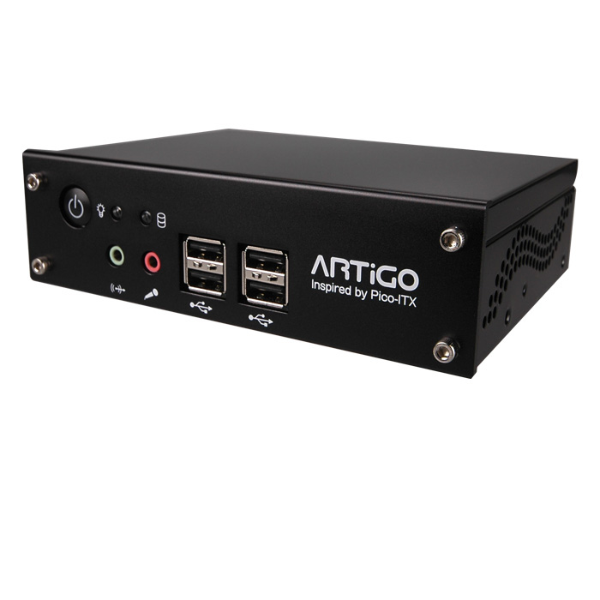
The Hoot System Hardware
Via ARTiGO A1000
C7 x86 Processor
1GB RAM
80GB Storage
On Board Video and Audio
60 watt power supply
4 USB 2.0 Slots

Slide 7
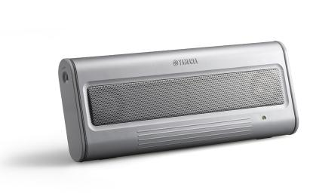
Audio Input
Yamaha USB Speakers
Sennheiser Microphone
USB adapter cables

Slide 8
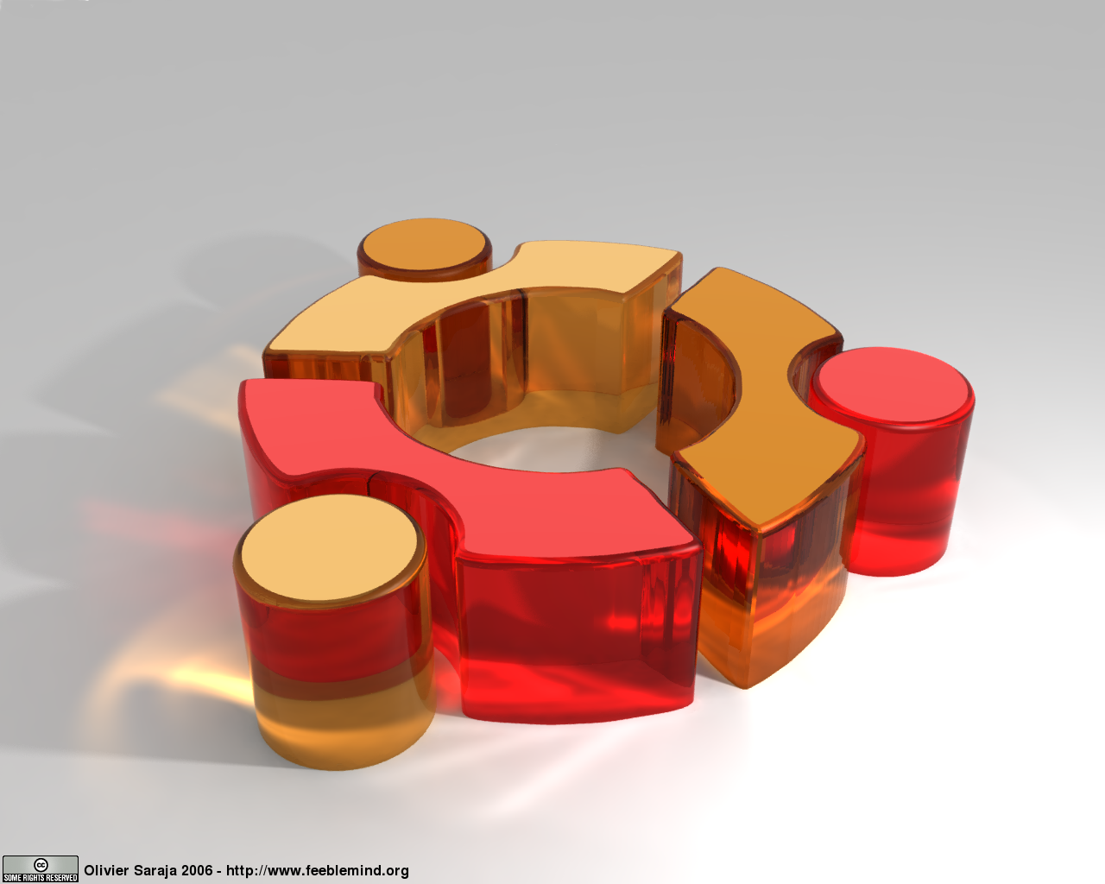
Operating System
Ubuntu 9.10
Karmic Koala
System has been modified.
Removed support for on board audio
ALSA has been modified to treat USB speakers and Microphone as a single device

Slide 9
System Start
System startup scripts and OS scripts
Detect USB Drive
Program files to system
Upload Audio files
Start Hoot Daemon
Set wake

Slide 10
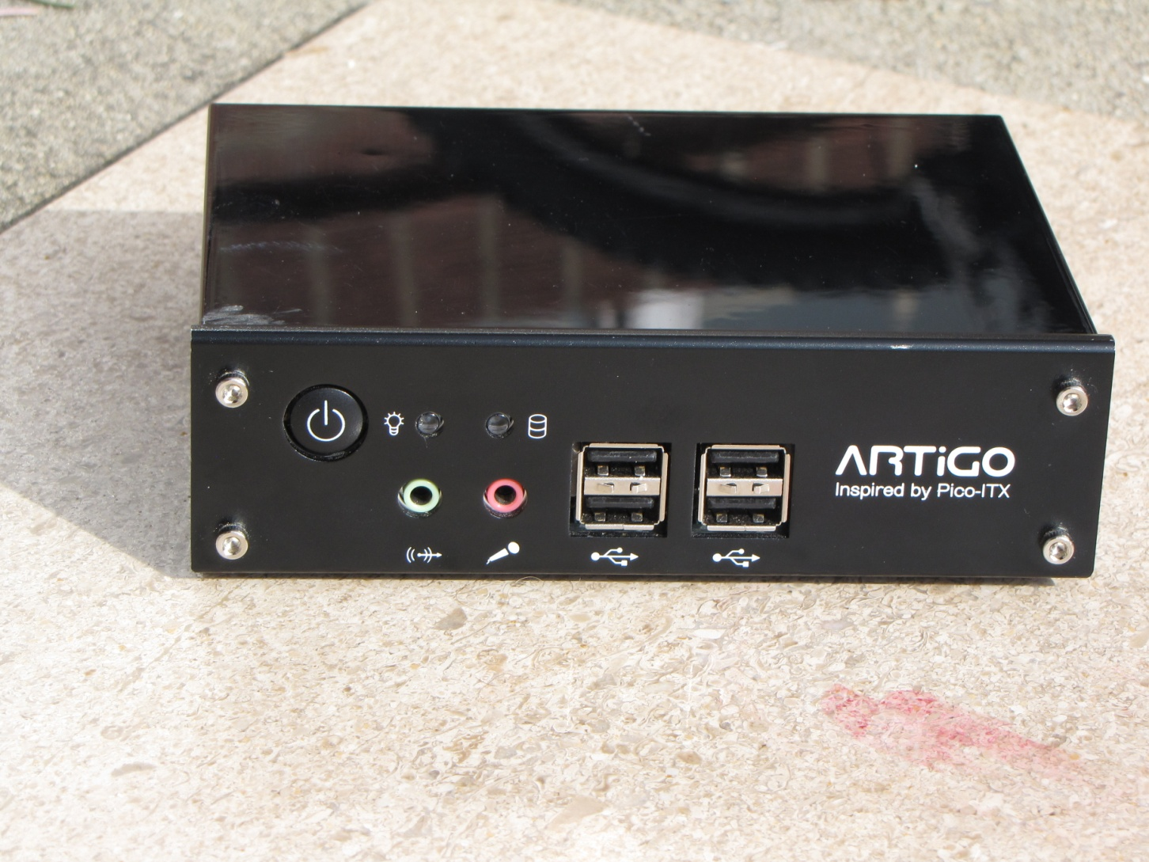
Hardware Specifications

Slide 11
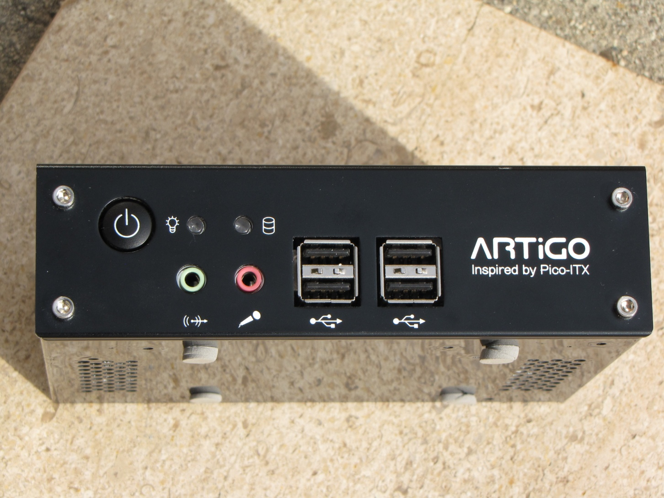
Hardware Specifications

Slide 12
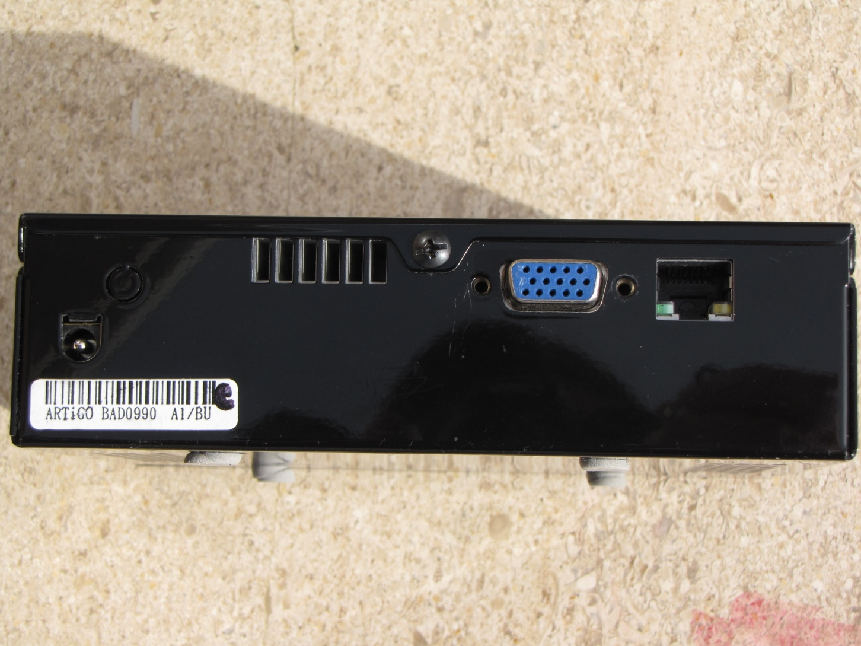
Hardware Specifications

Slide 13
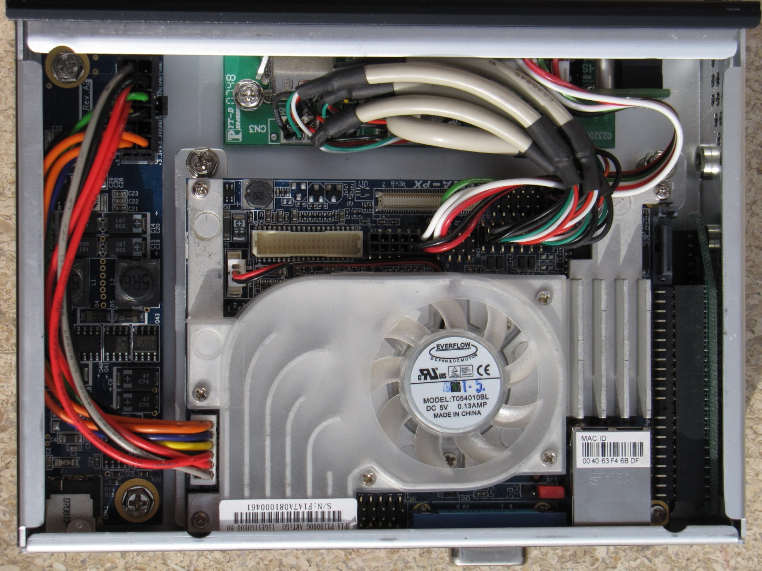
Hardware Specifications

Slide 14
Software

Slide 15
Overview
Uses a custom ScheduledEvent class to encapsulate everything related to an event.
Moving events to other days
Comparing events
Notifies the BindingList<T> as fields change
The main form utilizes a BindingList<ScheduledEvent> and remains bound to the list. *Any* change to the list’s objects will be automatically reflected on the DataGridView
Implements an event handler to facilitate the notifications of field changes
Utilizes an XmlSerializer and modifiers on accessors to tell the serializer what fields to serialize and how to format them.
Uses a Memento pattern to facilitate one-step undo

Slide 16
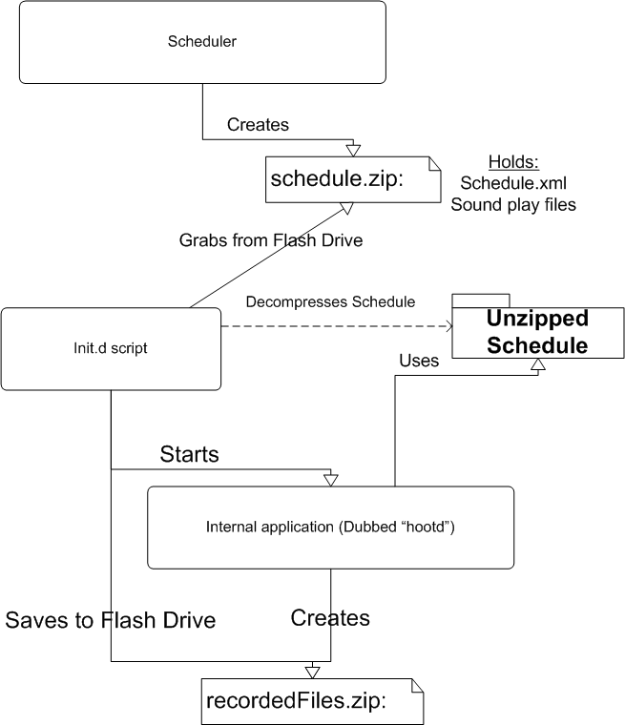

Slide 17
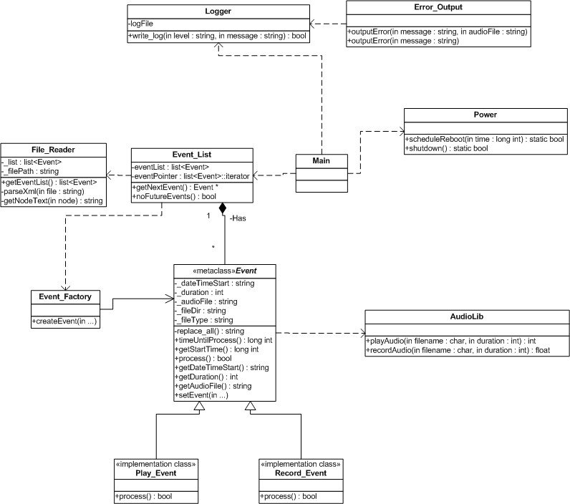

Slide 18
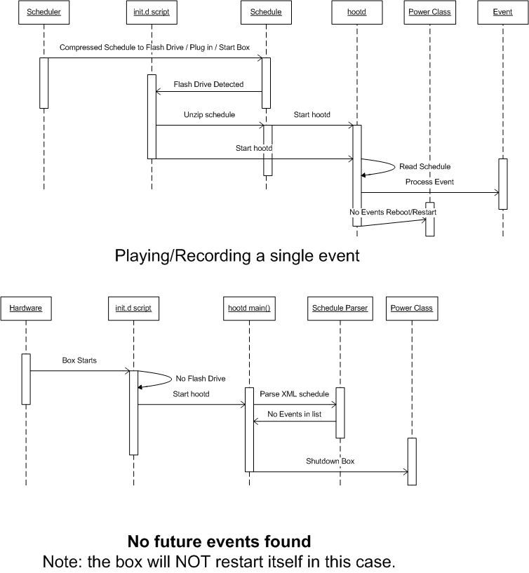

Slide 19
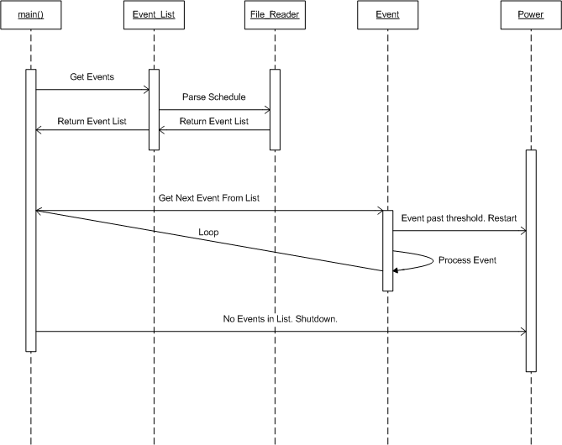

Slide 20
Scheduler GUI
Generates an XML-based representation of a schedule of events

Slide 21
Software Requirements
Device OS: Ubuntu 9.10.
Scheduler GUI: Any Windows environment.

Slide 22
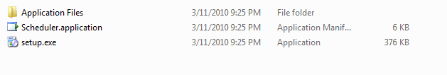
Installation
In Scheduler folder, Run Setup.exe:

Slide 23
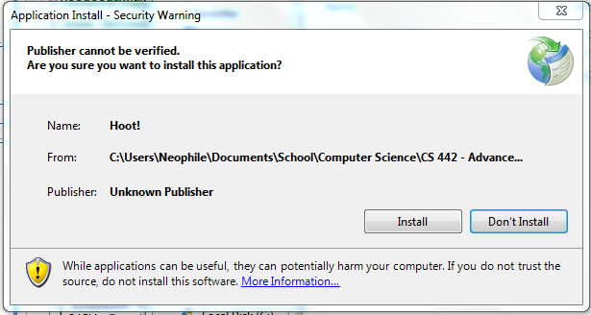
Installation
2. Click Install

Slide 24
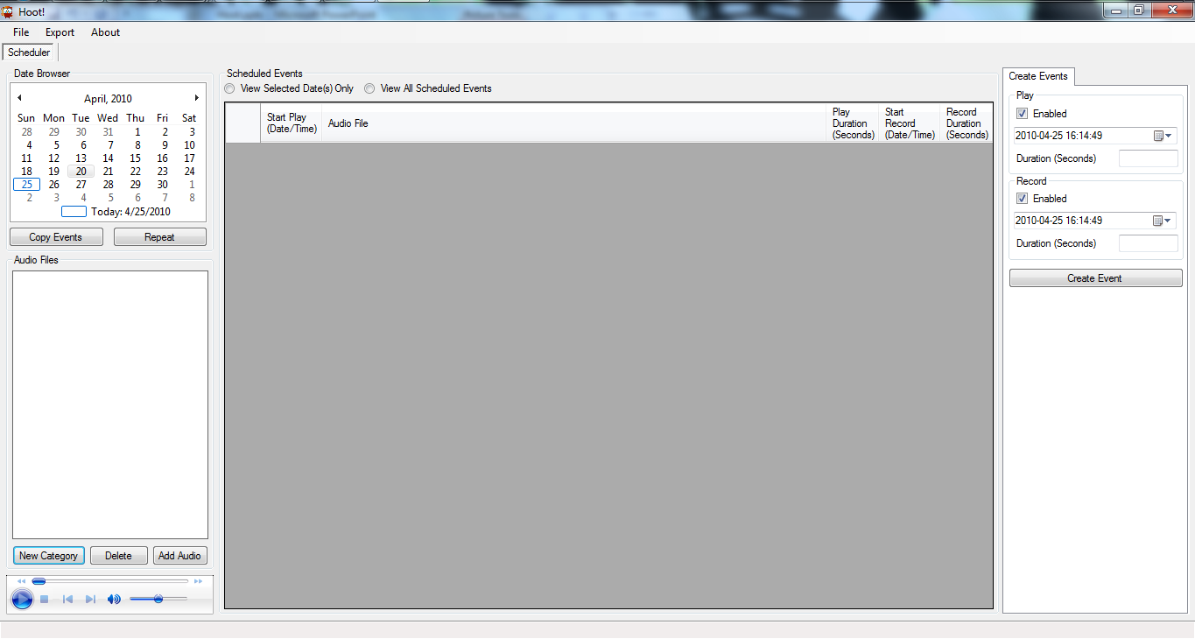
Installation Complete!

Slide 25
Creating a Schedule

Slide 26
Creating a Schedule
Create a Category
Add Audio
Create an Event
View All Events
View Specific Event
Copy/Paste an Event
Copy/Paste Multiple Events
Save Schedule
Export Schedule

Slide 27
Creating a Category

Slide 28
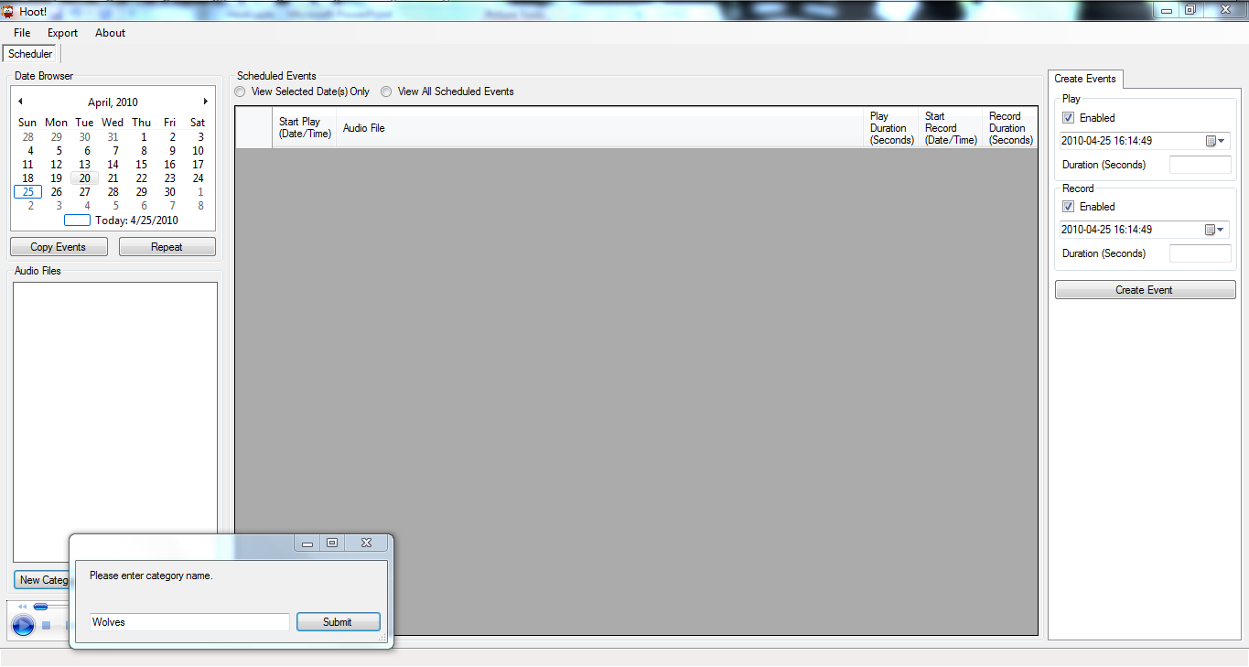
Creating a Category

Slide 29
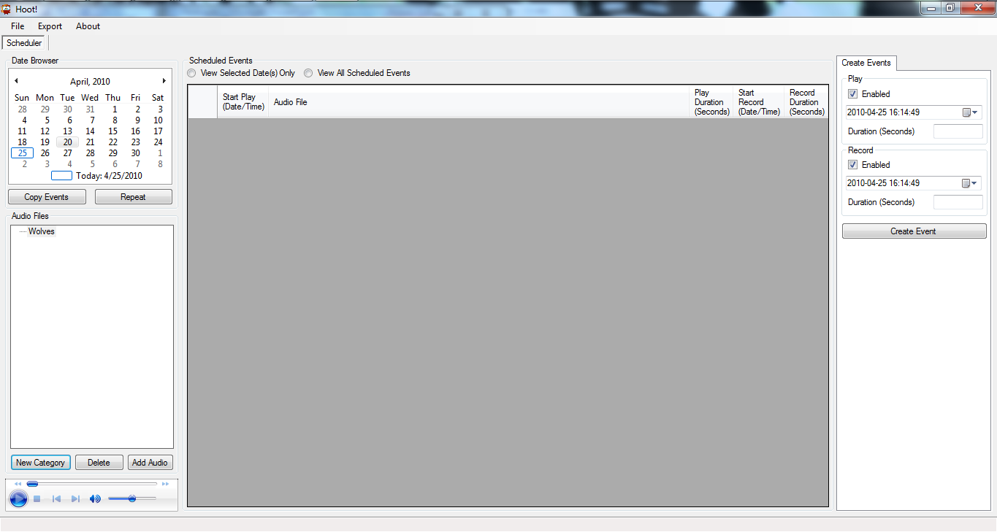
Creating a Category

Slide 30
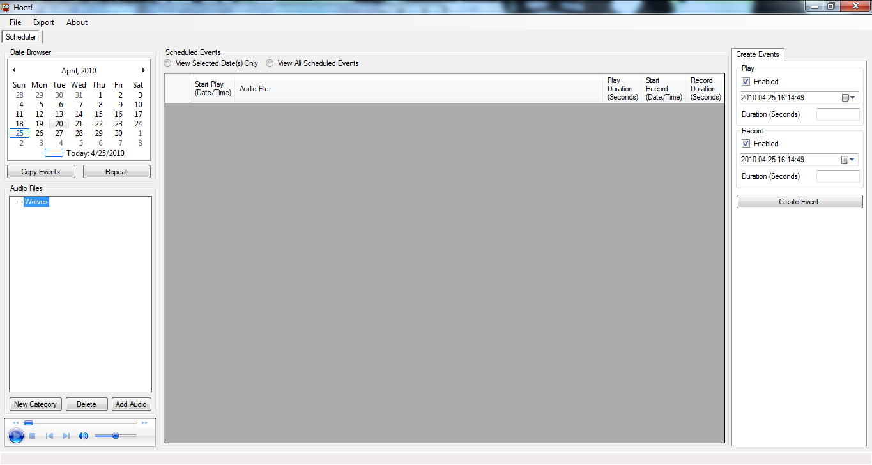
Adding Audio

Slide 31
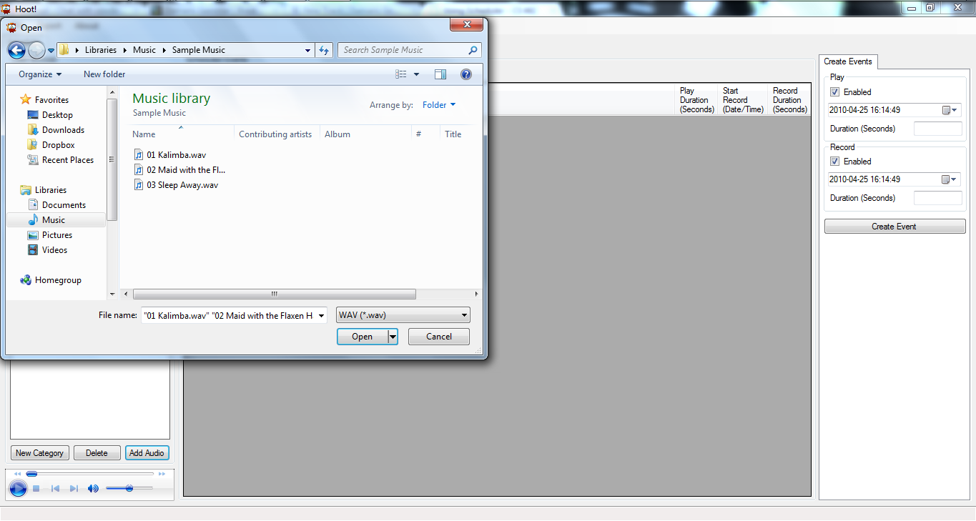
Adding Audio

Slide 32
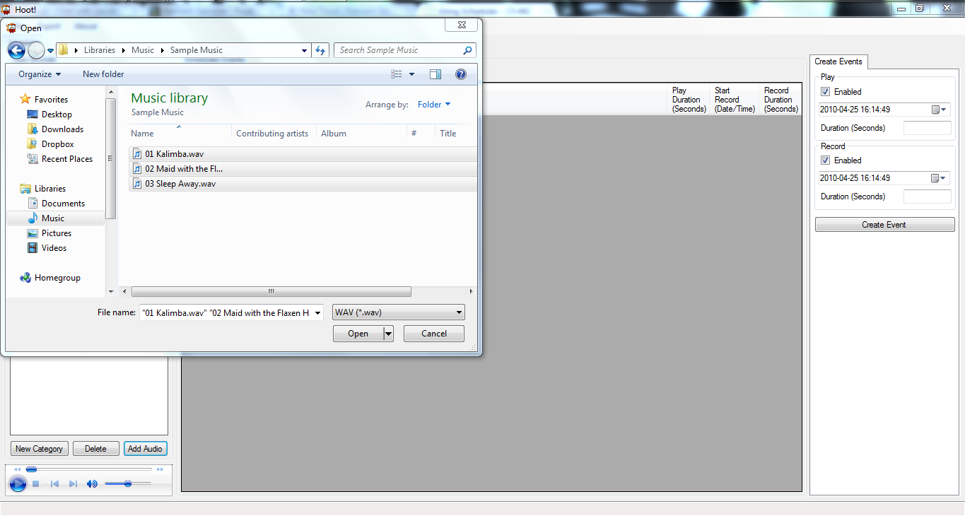
Adding Audio

Slide 33
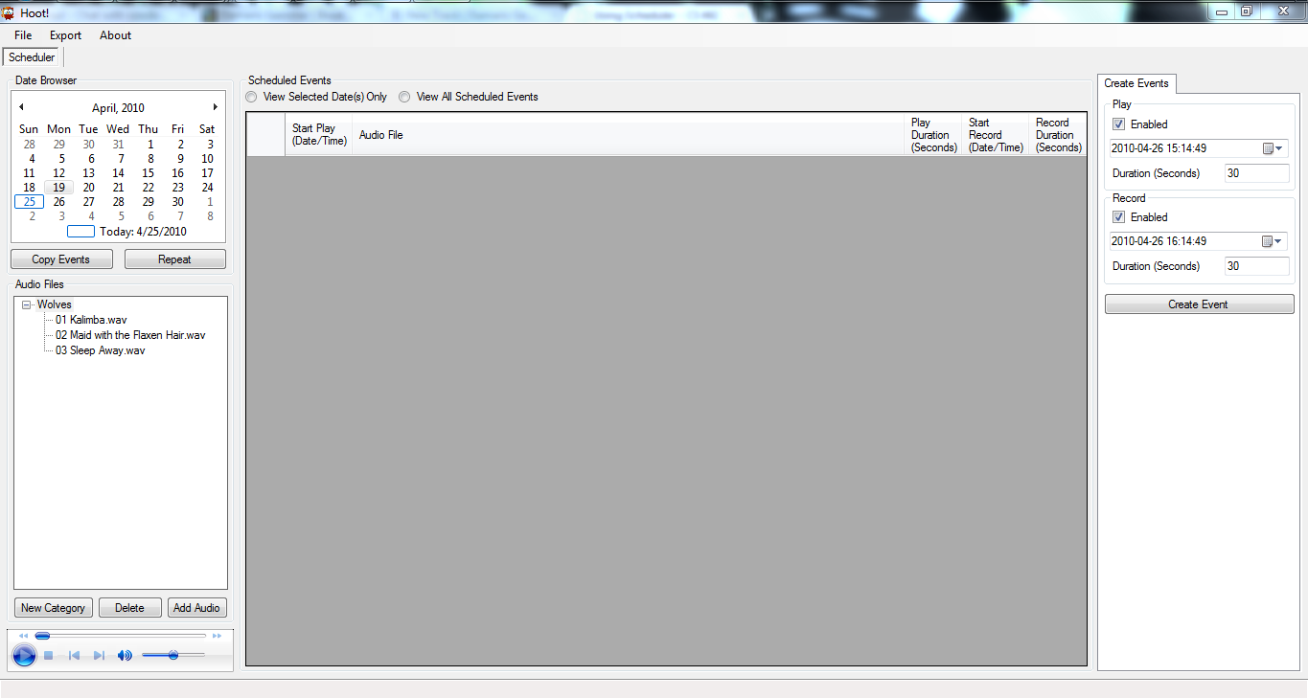
Adding Audio

Slide 34
Creating Event

Slide 35
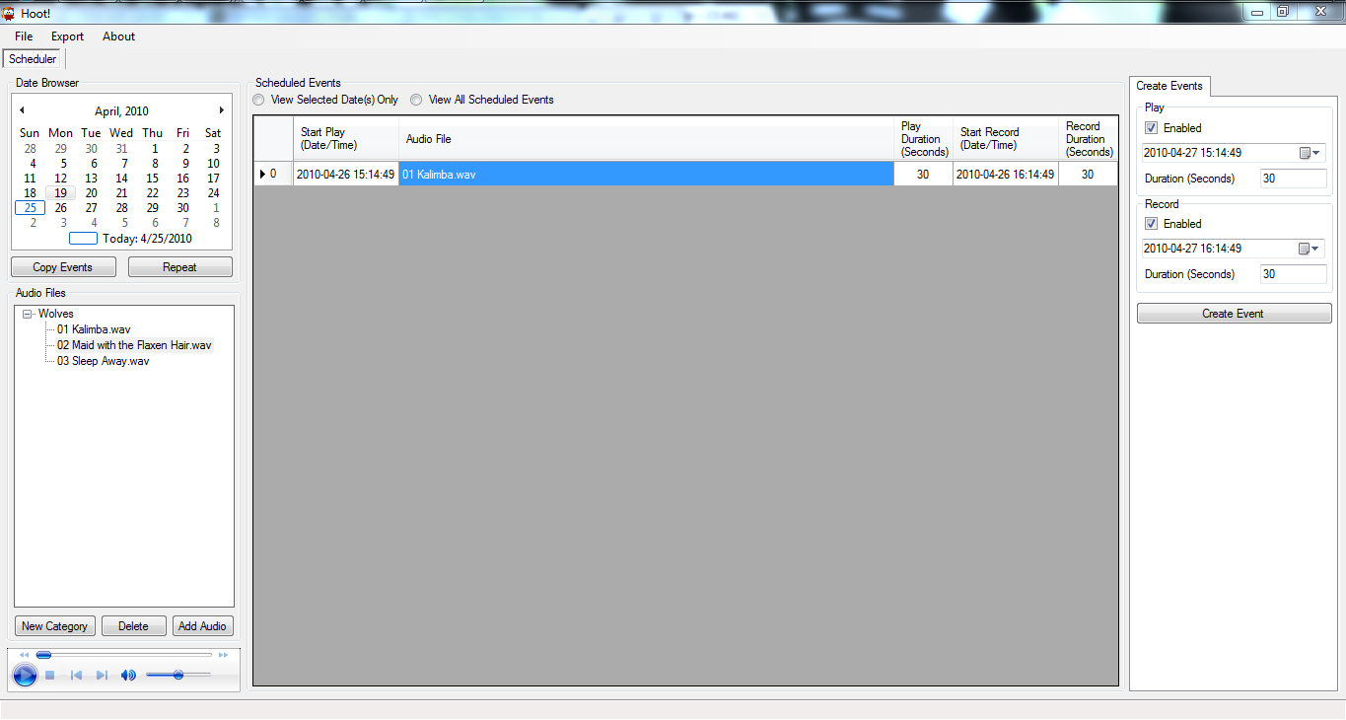
Creating Event

Slide 36
Viewing All Events

Slide 37
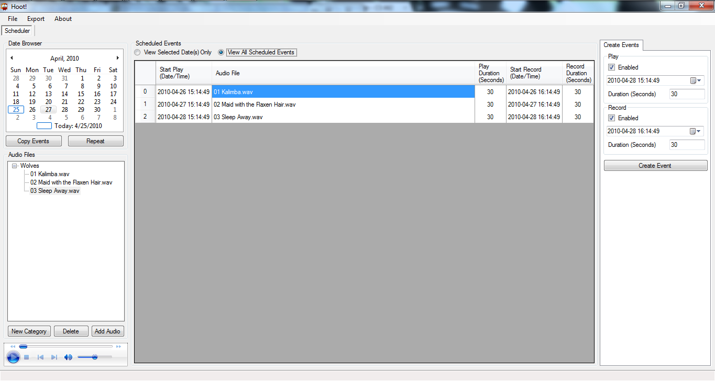
Viewing All Events

Slide 38
Viewing Specific Event

Slide 39
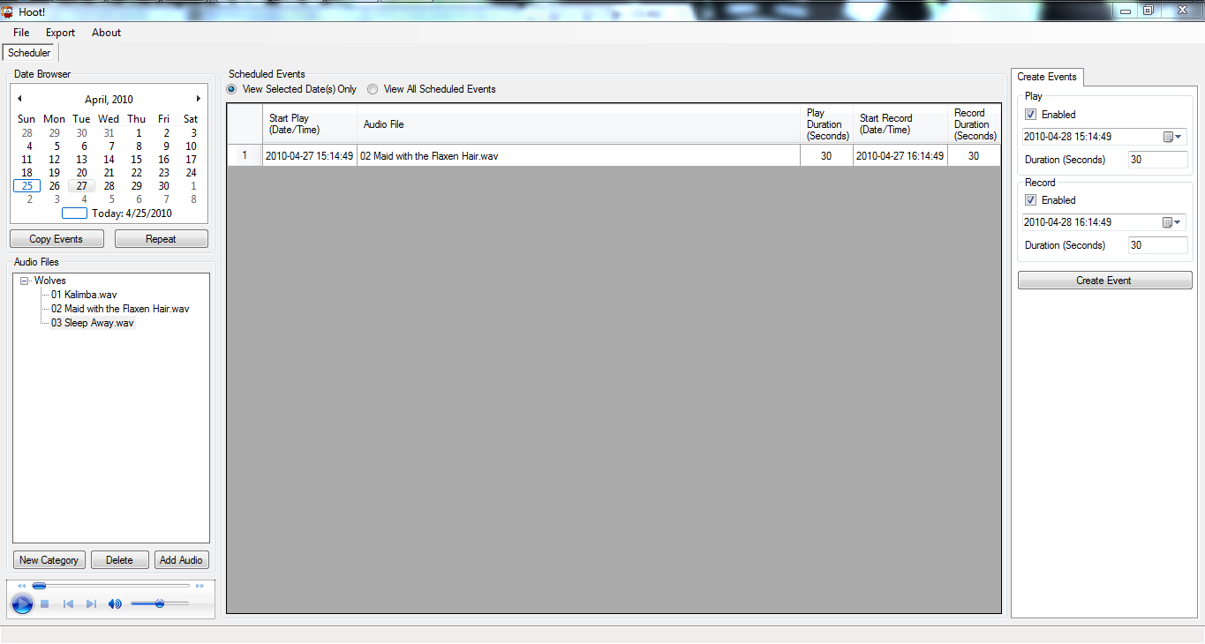
Viewing Specific Event

Slide 40
Copy Selected Events

Slide 41
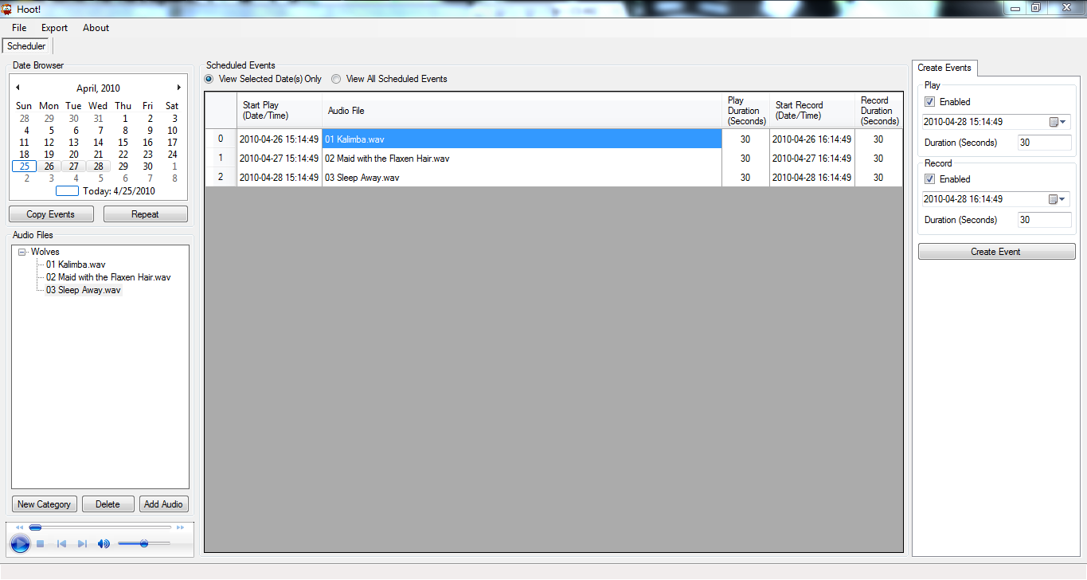
Copy Selected Events

Slide 42
Paste Selected Events

Slide 43
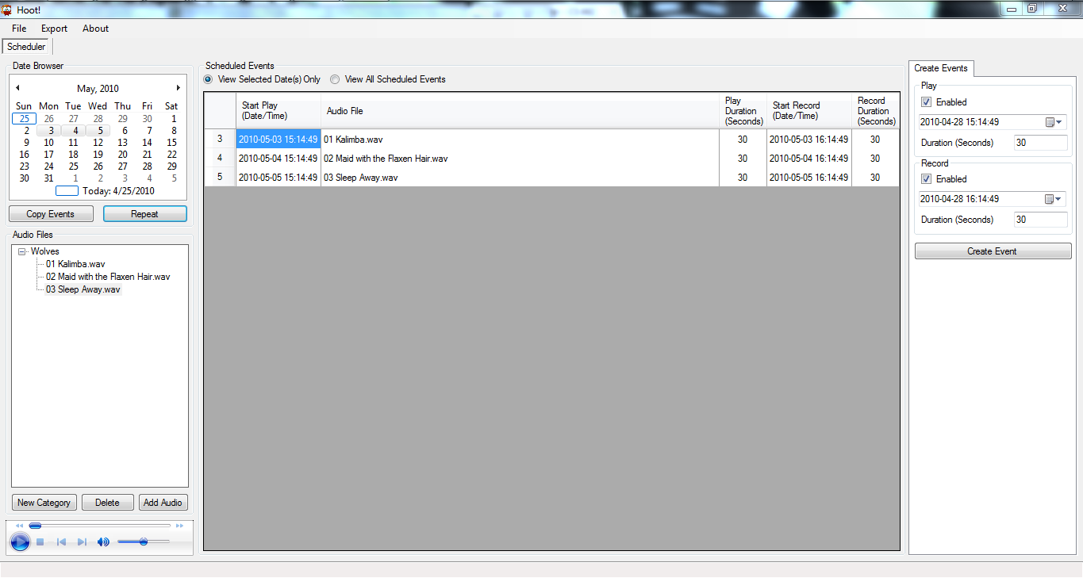
Paste Selected Events

Slide 44
Exporting Schedule

Slide 45
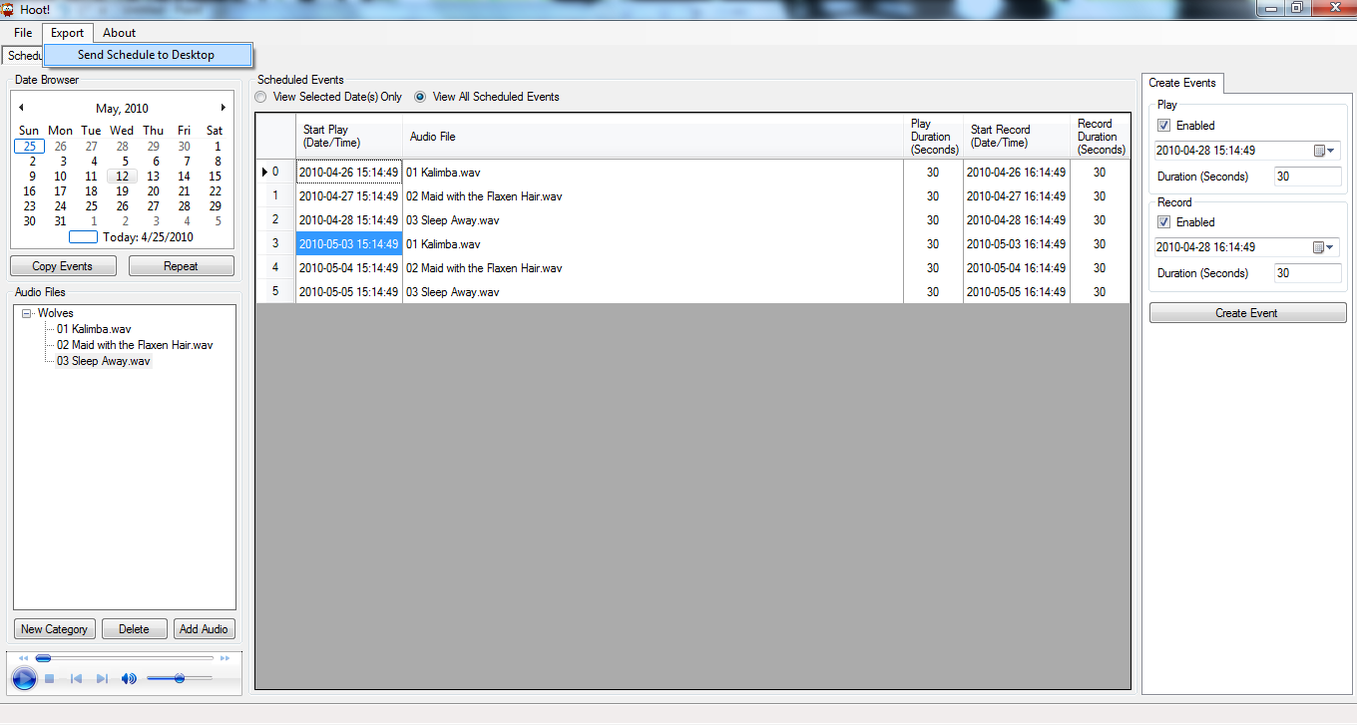
Exporting Schedule

Slide 46
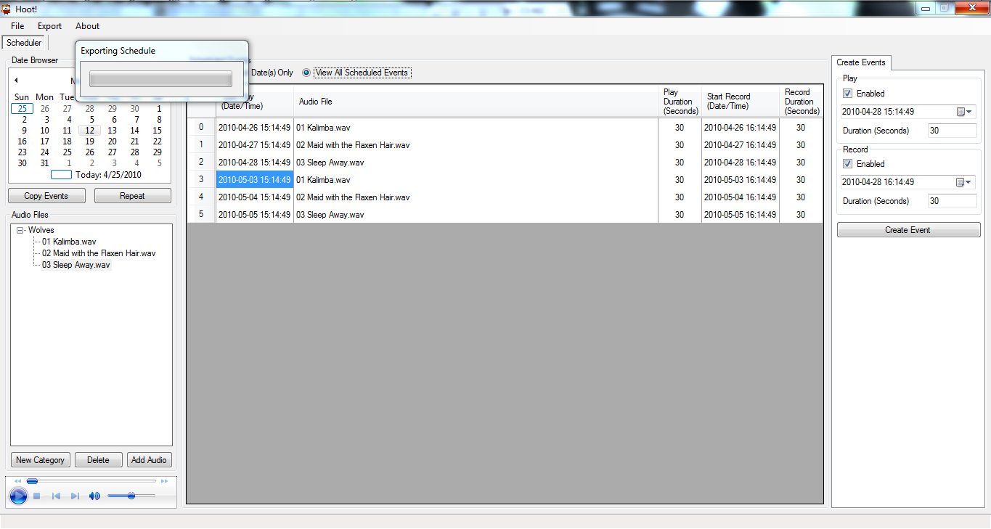
Exporting Schedule

Slide 47
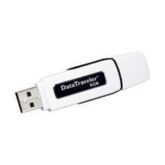
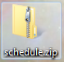
Exporting Schedule

Slide 48
Notes:
Must create a category to add audio
Must add audio to create an event
Error messages handle any potential problems with schedule creation
Inline editing/validation of event data is supported
Delete an event by clicking on the left arrow next to an event and hitting the delete key on your keyboard
To change the audio file associated with an event, select a new audio file from the Audio Files tree, then double click the event's audio file you want to update
Can create play/record events mutually exclusive of one another or together in a single event
Schedule.zip contains an .xml file of the events schedule and the associated audio files

Slide 49
Hoot Daemon

Slide 50
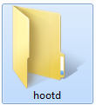
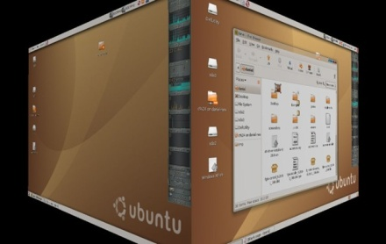
Installation
Copy hootd folder onto a flash drive
Paste hootd folder to desktop of device
Go into folder and execute install.sh

Slide 51
System Limitations

Slide 52
Limitations
Hardware
Battery life is low
Software
GUI is Windows only
Device Drivers for Debian Linux-Based OS’s only

Slide 53
Current Status

Slide 54
Current Status
Complete!
Working on future prototypes
Different hardware and/or software
Upgrade/add hardware components

Slide 55
Testing

Slide 56
Scheduler
Each version of the hoot scheduler was tested in three waves:
Audio Handling
Events
Schedule Handling
Each testing phase built upon the one before (i.e. Events depended upon the use of Audio Handling).

Slide 57
Audio Handling Sample Test Cases
Load audio files with the same name
Load multiple audio files at once
Load unsupported audio types
Play audio files

Slide 58
Events Sample Test Cases
Creating events with invalid inputs
Creating overlapping events
Edit events inline with valid data
Edit events inline with invalid data (i.e. record length on a play event)
Changing an events play file
Delete single/multiple events
Copy and paste single/multiple events to different days, weeks, months
Copy and paste overlapping schedules
View created events

Slide 59
Schedule Handling Sample Test Cases
Saving a schedule using "Save as..." and "Save To..."
Exporting created schedule
Opening saved schedule

Slide 60
Bugs Discovered
Audio files with the same name can be loaded into the Scheduler
An audio file removed from the hard drive still shows in the file tree
Events are can be scheduled to overlap
Can edit duration of Record when event is Play only and vice versa
If user is on View Selected Date(s) Only, the first event from the date copied shows up in the day repeated upon until refreshed
Clicking "Repeat" with no events copied throws a nasty error

Slide 61
Hardware / hootd
Test pieces
Shut down/Weak up
Test the application by modifying test.xml file
Test recording
Test USB transfer scripts
Installation of the application using install/uninstall scripts
Final testing
Bugs
The application did work for events of current day
If the interval of two successive events longer than10 minutes in play/record event, it did not record
USB Transfer scripts unzip the schedule.zip to wrong directory(Source)
The system won't mount USB device
Mic/Speaker issues
USB Transfer scripts unzip the schedule.zip to wrong directory(Source)

Slide 62
The Future of Hoot

Slide 63
What Do We Have Now?
HARDWARE
Small Form Computer
External Speaker
External Microphone
External Battery(s)
USB Flash Drive
SOFTWARE
Event Scheduling Interface
USB Transfer Script
Hoot Daemon

Slide 64
What Does This Allow Us To Do?
Play audio files at a designated time.
Record form environment at designated time.

Slide 65



What Are The Limitations?
You must choose a time of day to schedule an event. This is the only time this event will fire.
The battery life of the device is very limiting.
You need to physically visit the device to update schedules, retrieve recordings or interact with the system.

Slide 66

Any Other Concerns?
The use of different operating systems on the scheduling computer and on the box which is deployed in the wilderness prevents any possibility of building, updating, or maintaining a schedule on the deployed box while in the field, even if all of the necessary peripherals were available.

Slide 67

How Can We Improve?
Lets start by standardizing operating systems.
The scheduler and daemon should both be fully supported by Windows. This will provide the optimal support for peripheral driver support as well as provide an additional level of familiarity to the user of the system.

Slide 68
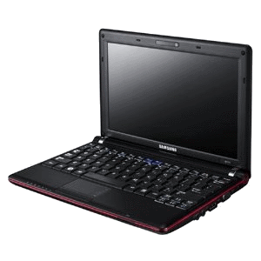
Lets Talk About Hardware!
A netbook is the perfect solution to our problem. Switching the daemon to run on a netbook would simultaneously solve almost all of the limitations that were discussed previously. Specifically, we can use Windows and the default battery life of these netbooks exceed 10 hrs.
Samsung N110-12PBK 10.1-Inch Black Netbook ---->

Slide 69
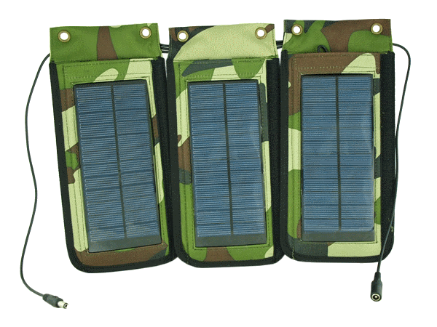
But We Want More…
If the increased batter life of 10+ hours is still insufficient, a solar charger can be used to trickle charge the low-powered netbook while in the field. This should provide the benefit of less frequent need to replace batteries on field devices.
<---- Portable Solar Power Charger
http://www.netbookcrunch.com/best-netbook-solar-chargers/

Slide 70
Okay, Lets Look At The Software!
Couldn’t we do more with the software than play and record audio at a given time of day?
What if we could setup a variety of triggers which could be used to initialize action sequences?

Slide 71
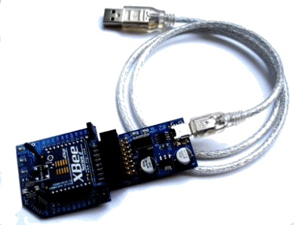
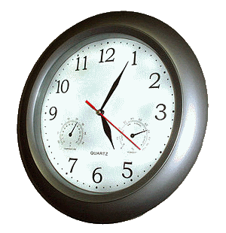
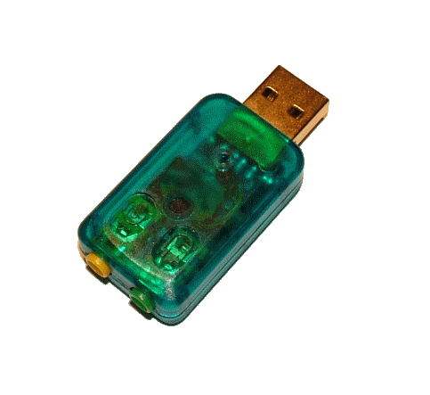
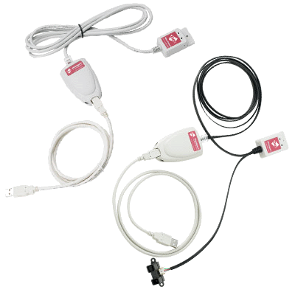
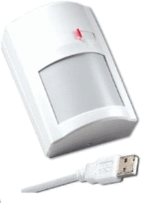
What Types Of Triggers?
Time Of Day – Based off of system clock.
Sensors
Movement
Temperature
Light
Audio (Mic w/ threshold)
Video
Combinations of requirements.

Slide 72
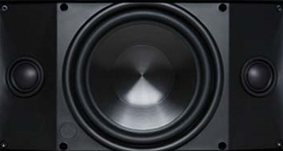
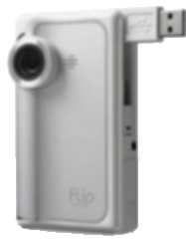

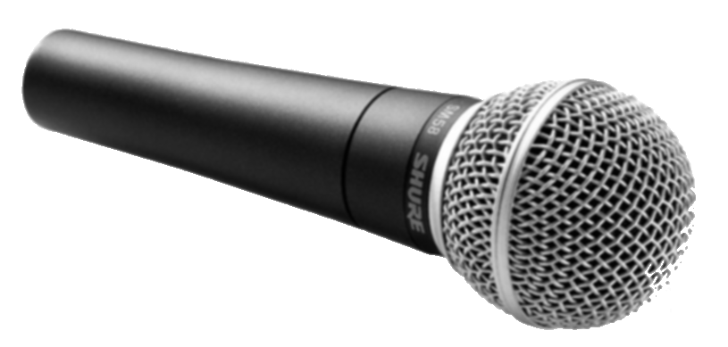
What Type Of Action Sequences?
A trigger could activate any combination of the below actions in a sequence.
Actions:
Play Audio
Record Audio
Record Video
Record Sensor Readings
Successive Actions or Simultaneous Actions

Slide 73

Some Other Improvements
In-Field Scheduling
The scheduler (action center) would support both importing a schedule created on another machine as well as on-the-fly creation of schedules using the I/O peripherals provided by the netbook.
Remote Accessible
The files and data recorded by the netbook should be available via a server. This data could be accessed via standard wireless networking (802.11x) as well as via the internet in regions where cell service is available by using mobile broadband wireless.

Slide 74
Questions?

